Slide 1

CUSTOMER RETENTION PROJECT
BY
PANKAJ ADHIKARI

Slide 2
INTRODUCTION
Online Shopping has been one of the fastest mode of selling goods. Although there are a lot of website that sell variety of good ranging from apparel to electronics, most of the customers are not convinced by the quality service provided by the website. Hence, they tend to hop from one website to another to find the best deal of items and services. Thus, website find it difficult to retain the customers to comeback for second purchase. To address this problem most of the website tend to attract the customers with various deals and subsidies to retain them but sometimes that is not enough. This bring us to the customer activation and retention mechanism where a set of questionnaire are researched to find whether the customer revisit the website for repurchase.

Slide 3
PROBLEM DEFINITION
This Data set represent the sentiment of customers during online shopping across various websites. The goal here is to determine whether the websites are able to retain the customers for second purchase. This is only possible by careful analyse the Data set provided.

Slide 4
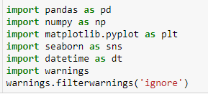
DATA ANALYSIS
In this section we perform Exploratory Data Analysis (EDA) so as to gain insight on Data.
IMPORTING LIBRARIES
We begin by importing important Libraries

Slide 5

DATA ANALYSIS
UPLOADING DATA SET
After importing Libraries we uploading the data using the excel file provided in two different DataFrames
df1 → Contain the Detail Description of Dataset. Enabling us to analyse the data in encoded form
df2 → Contain the Encoded form of the Dataset. Enabling us to analyse the data in encoded form
SHAPE OF DATA
The Shape of the data is rows = 269 & column =71

Slide 6
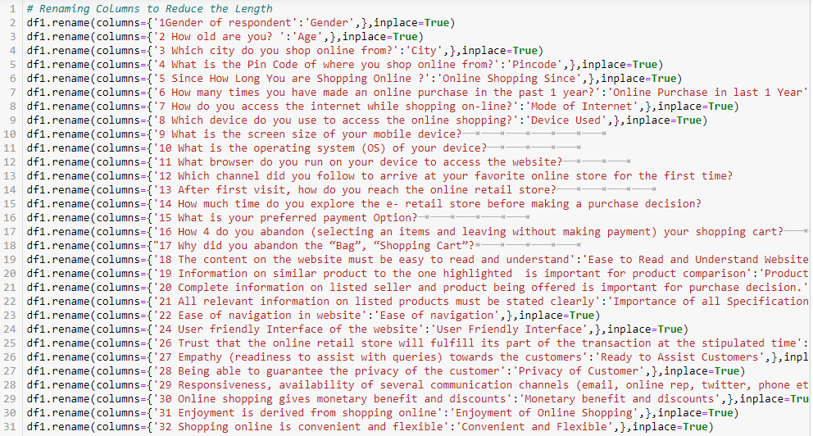
DATA ANALYSIS
RENAMING THE COLUMN
In this section we rename the column to reduce the length so that it can be presentable.

Slide 7
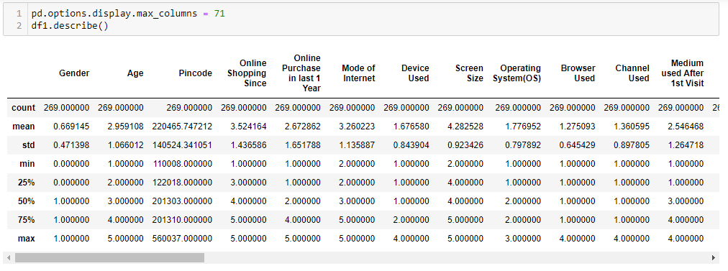
DATA ANALYSIS
DATA INFO
We view the info of Detail data using the df.info()
DESCRIBING DATA

Slide 8
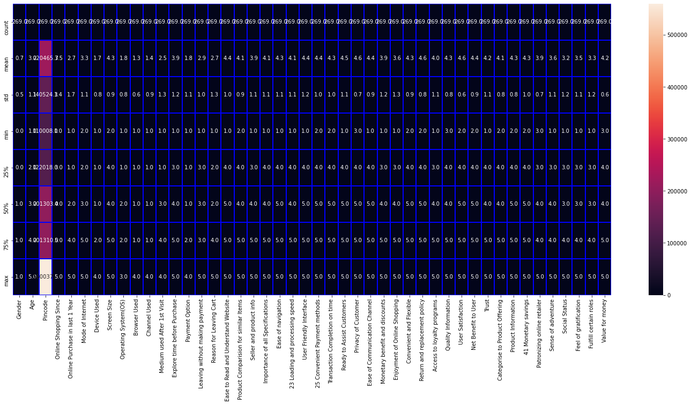
DATA ANALYSIS
DESCRIBE HEAT MAP

Slide 9
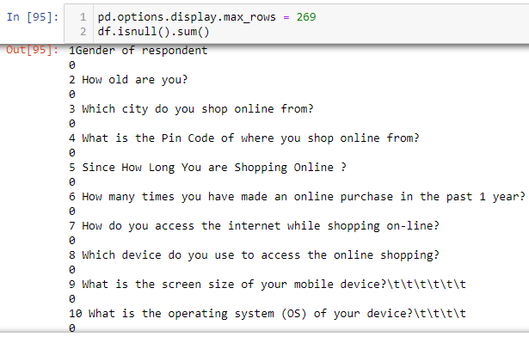
DATA ANALYSIS
NULL VALUE
In the above figure we find that there is no missing value in the dataset

Slide 10
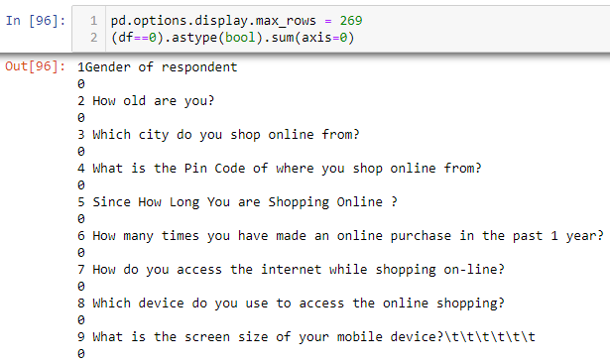
DATA ANALYSIS
ZERO VALUE
In the above figure we find that there is no zero value in the dataset

Slide 11
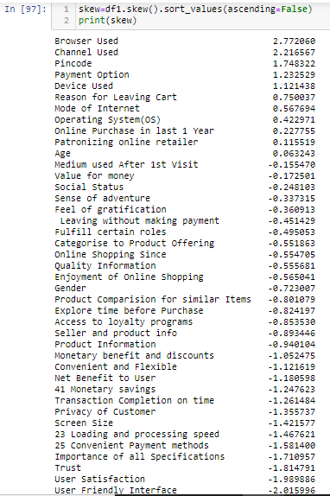
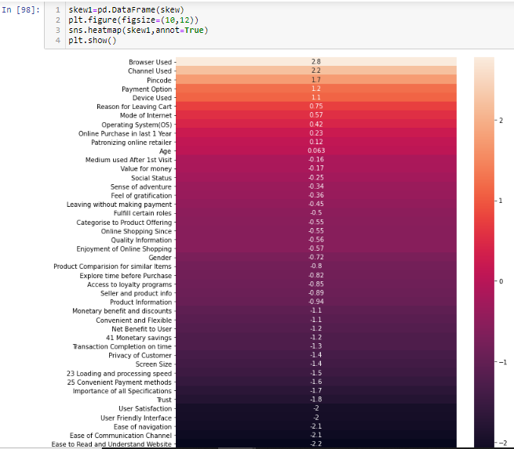
DATA ANALYSIS
SKEWNESS

Slide 12
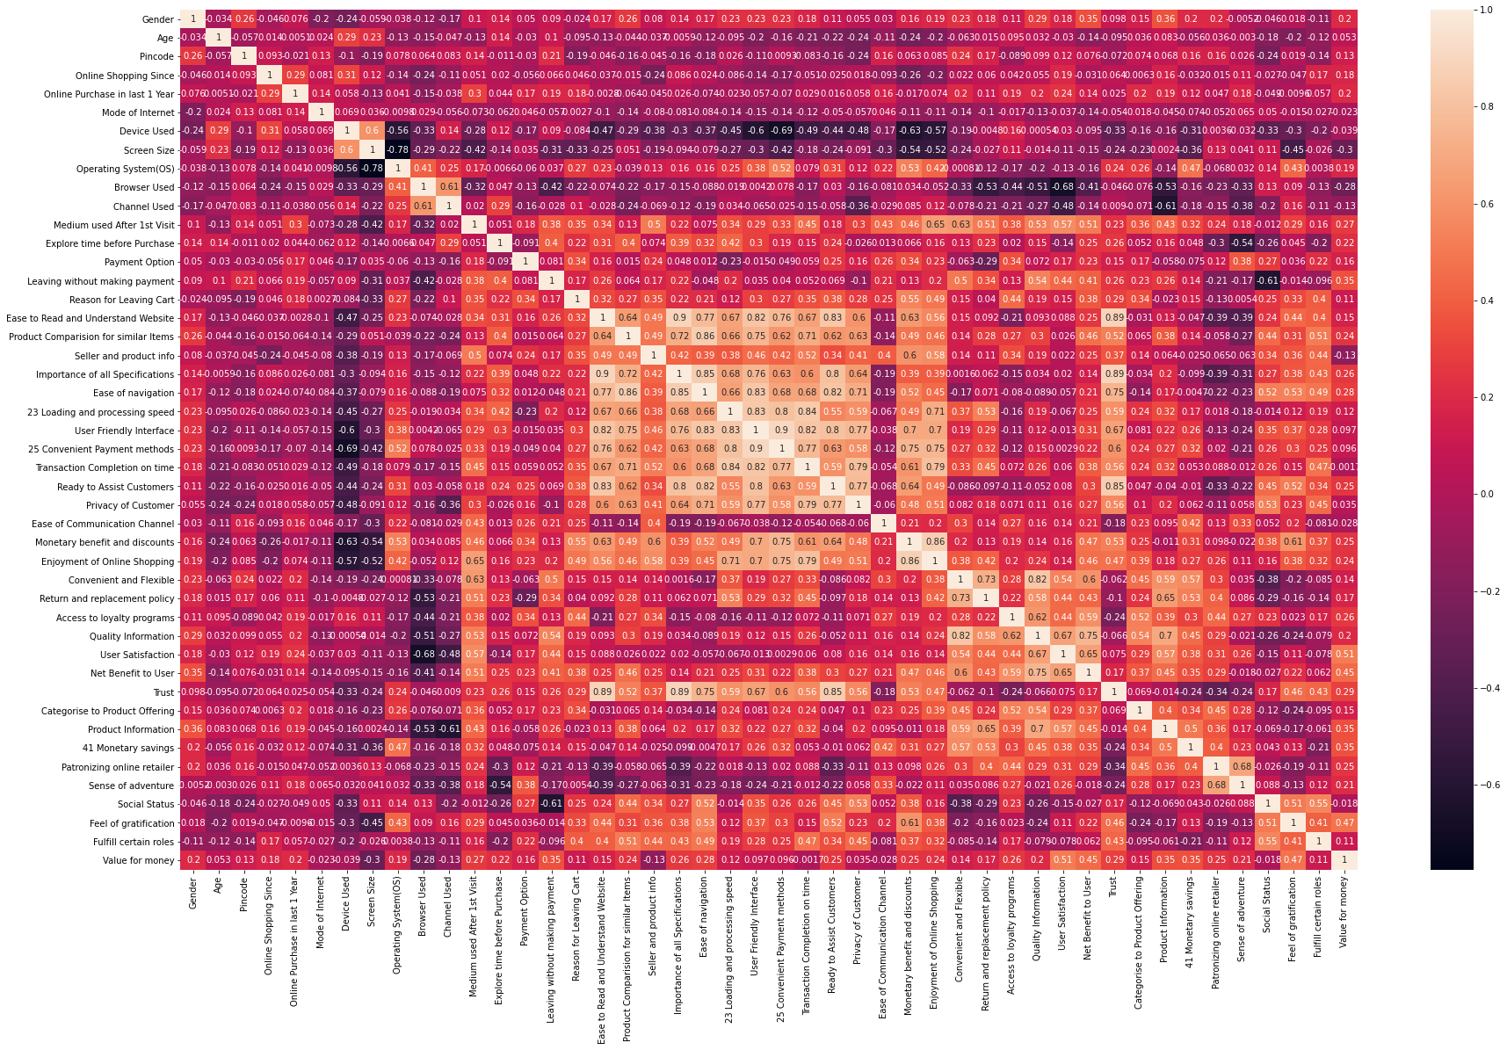
DATA ANALYSIS
CORRELATION HEAT MAP

Slide 13
DATA ANALYSIS
CORRELATION HEAT MAP
In the above Correlation Heat map, we have the following observations:
Most of the high correlation is concentrated between “Ease to Read and Understand Website” and “Privacy of Customers”
Screen Size and Operating System has the lowest Correlation.
“Convenient Payment Method” and “User Friendly Interface” have high Correlation.

Slide 14
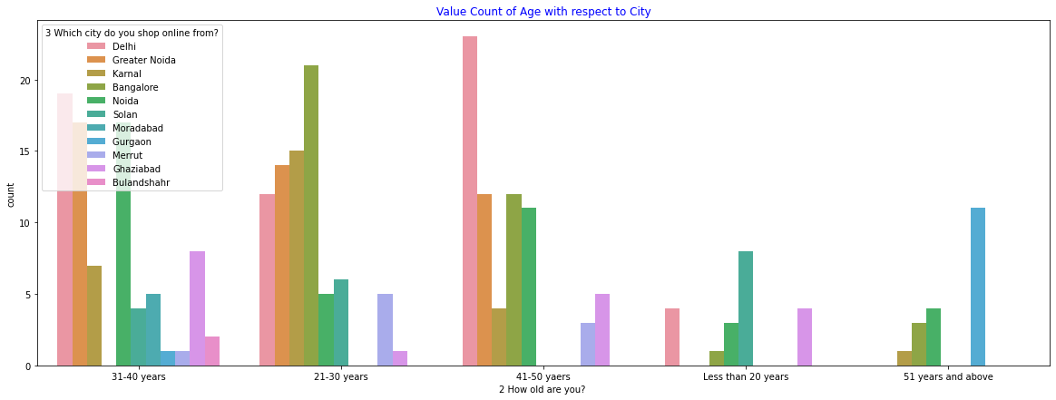
DATA ANALYSIS
PLOTS AND GRAPHS
In the above Figure we have observe the following:
“21-30 years” age group has the highest count.
Bangalore has the highest count in “21-30 years” age group.
“51 years and above” age group has the lowest count.
Bangalore have no user in “31-40 years” age group.
Gurgaon and Moradabad have no user in “21-30 years” age group.
Solan, Gurgaon and Moradabad have no user in “41-50 years” age group
Figure : Value Count of Age with respect to City

Slide 15
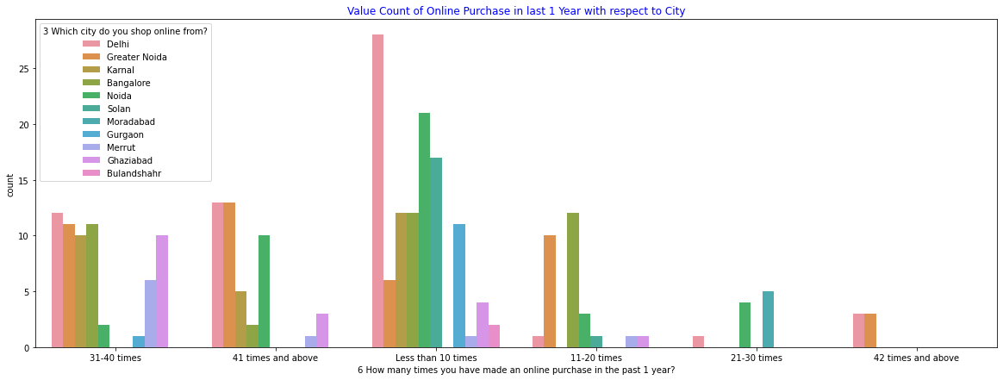
DATA ANALYSIS
In the above Figure of we have observe the following:
The highest count of data lies in “Less than 10 times” value in which Delhi takes a lead and Moradabad has zero count.
Delhi has the highest combine count from all group.
Moradabad has zero combine count from all group.
“42 times and above” group has the lowest count.
Figure : Value Count of Online Purchase in last 1 Year with respect to City

Slide 16
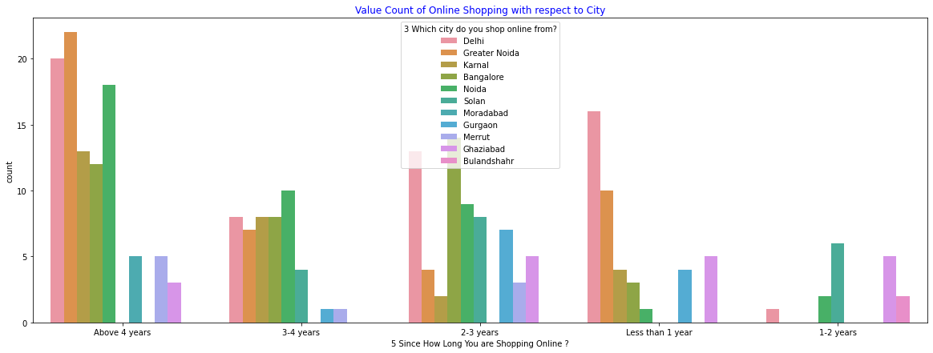
DATA ANALYSIS
In the above Figure of we have observe the following:
“Above 4 years” has the highest count.
Delhi have the highest combine count in all groups.
Bulandshahr have the lowest combine count among all the groups.
Figure : Value Count of Duration of Online Shopping with respect to City

Slide 17
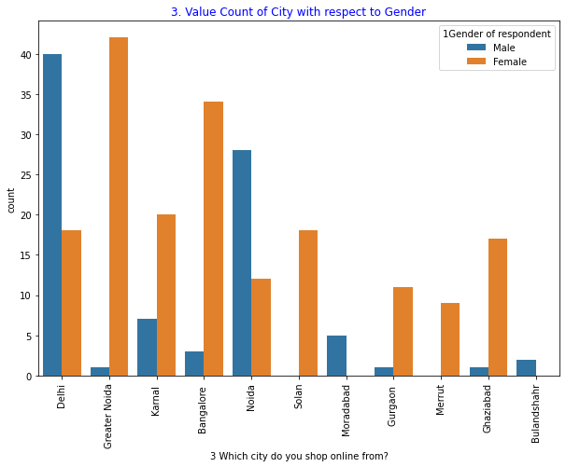
DATA ANALYSIS
In the above Figure of we have observe the following:
Female have the highest combine count among all the Cities.
Solan and Meerut have zero Male Count.
Moradabad and Bulandshahr have zero Female Count.
Male and Female count is highly imbalance in Greater Noida.
Figure : Value Count of City with respect to Gender

Slide 18
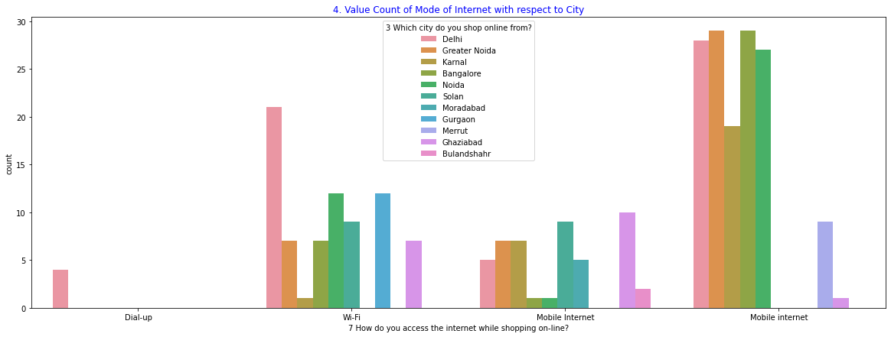
DATA ANALYSIS
In the above Figure of we have observe the following:
Mobile internet has the highest count among all the modes of internet.
Dial-up is used in Delhi only.
Delhi has the highest access to Internet
Bulandshahr has the lowest access to internet.
Figure : Value Count of Mode of Internet with respect to City

Slide 19
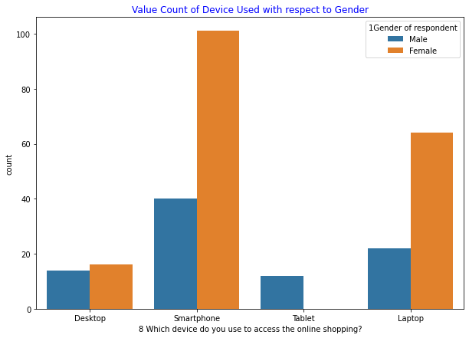
DATA ANALYSIS
In the above Figure of we have observe the following:
Female has the highest count among all the device usage.
Female do not use tablet.
Smartphone is the most common device.
Desktop is usage is almost equal.
Figure : Value Count of Value Count of Device Used with respect to Gender

Slide 20
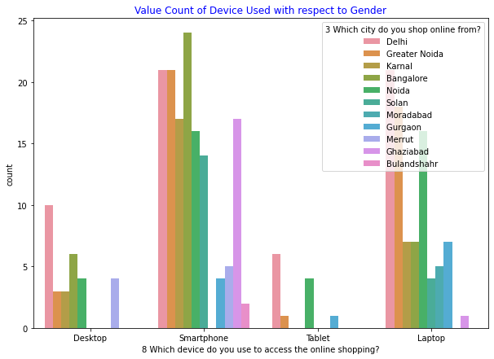
DATA ANALYSIS
In the above Figure of we have observe the following:
Smartphone is the most common device.
Bangalore has the highest use of Smartphone.
Smartphone usage in Delhi and Greater Noda is the same.
Tablet is least popular device.
Figure : 'Value Count of Device Used with respect to City

Slide 21
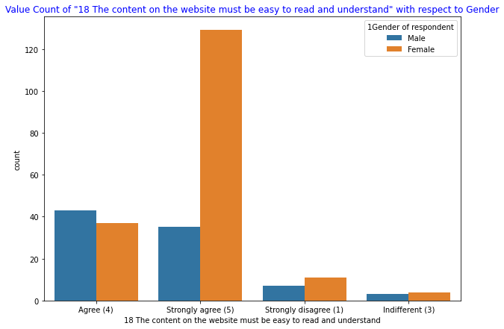
DATA ANALYSIS
In the above Figure of we have observe the following:
Female has the highest count among all the group.
Male has highest count in “Agree”.
Figure : Value Count of "18 The content on the website must be easy to read and understand" with respect to Gender

Slide 22
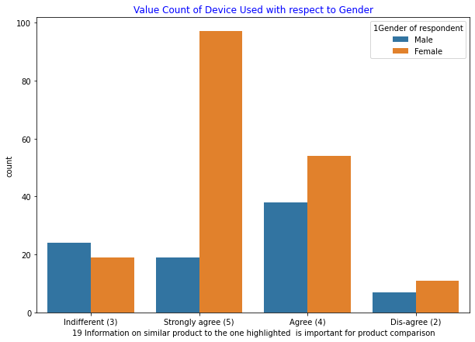
DATA ANALYSIS
In the above Figure of we have observe the following:
Female has the highest count among all the group.
Male has highest count in “Indifferent”.
Figure : Value Count of Information on similar product with respect to Gender

Slide 23
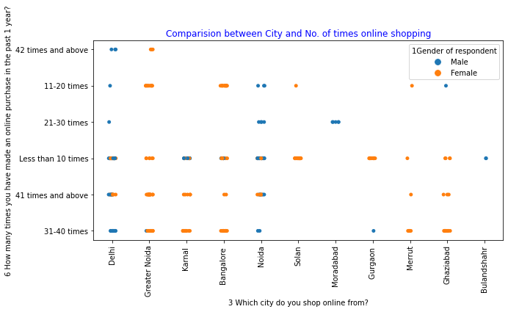
DATA ANALYSIS
In the above Figure of we have observe the following:
Delhi and Noida has the highest times in Online Shopping.
Greater Noida, Merrut, Ghaziabad and Solan has mostly Female Shoppers.
Bulandshshr and Moradabad has mostly Male Shoppers.
Bulandshshr has the least shopper among groups.
Figure : Comparison between City and No. of times online shopping

Slide 24
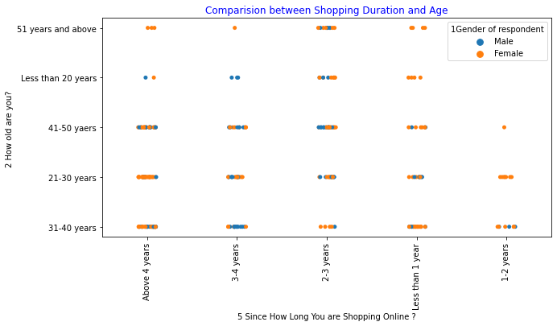
DATA ANALYSIS
In the above Figure of we have observe the following:
Shopper are mostly Female.
Shopping duration 3-4 years and Age Group of Less than 20 years are all Male.
Figure : Comparison between Shopping Duration and Age

Slide 25
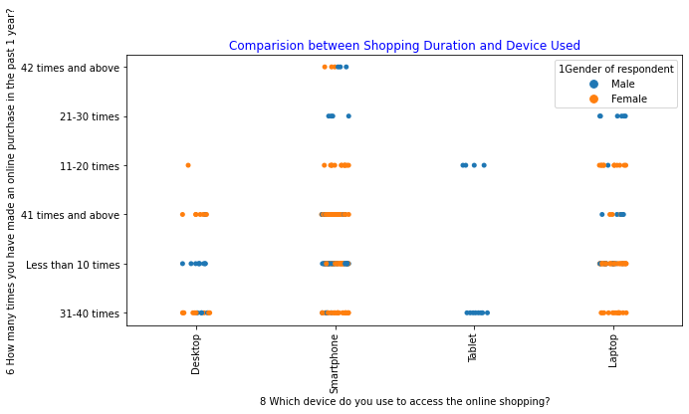
DATA ANALYSIS
In the above Figure of we have observe the following:
Smartphone has the highest duration.
Tablet has the least duration.
Tablet are used by Male only.
Figure : Comparison between Shopping Duration and Device Used

Slide 26
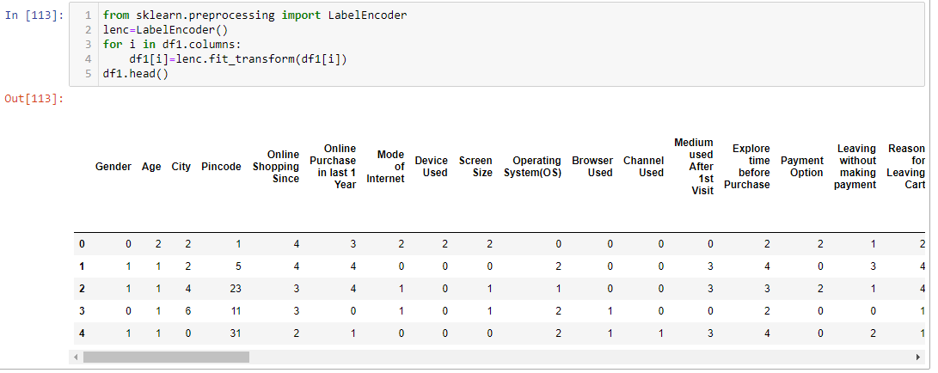
DATA ANALYSIS
LABEL ENCODING OF COLUMNS
In the above Figure we use Label encoding to Encode the Data furth so that it can be use in Machine Learning.

Slide 27
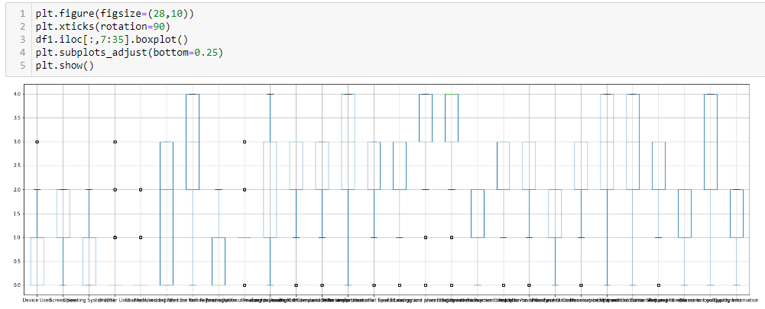
DATA ANALYSIS
REMOVING OUTLIERS
In the above Figure we use Boxplot and find a lot of outliers in the Dataset.
Figure : Box Plot of Columns

Slide 28
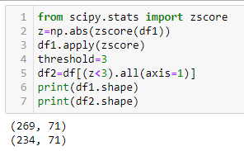
DATA ANALYSIS
REMOVING OUTLIERS
In the above Figure We use Z-Score to eliminate the outliers in the Dataset and derive df2 having 234 rows and 71 columns.

Slide 29
EDA CONCLUDING REMARK
In this Project we perform basic EDA of Dataset. As there are two file (Detail & Encoded) we used both to analyse the dataset and complete the EDA.

Slide 30
THE END

